Slide 1



AUTOMATION in
Machine Maintenance
17th May 2022

Slide 2
Basic Objective
■
Management of ROYAL Infraconstru Ltd is keen to introduce Automation in their Machine Maintenance activity scattered across various geographic locations to enable improvement in Revenue, Profitability.
Preventive Maintenance (PM)
Predictive Maintenance (PdM)
Corrective/Reactive Maintenance (CM)
■
TRICO conducted a dip-stick analysis of current and future business, interacted with TOP Management of ROYAL Infraconstru Ltd to understand key challenges and identify potential areas of improvement in the Machine Maintenance activity.
Introduce & Streamline the Maintenance Management (Automatic Scheduling, Monitoring & Governance) with Biz Intelligence.
Automatic Indication of PM status (Done – Due – Overdue) in Android Mobile App for each M/c with visual identification.
Introduce Governance in Fuel Management and better Spend Visibility in Spares and Services for each Machine.
Highlighting Sales/Production Loss (if any) due to delay in PM leading to breakdown or during breakdown.
Robust Asset Management of each machines indicating ownership (Own – Sister Concern – Vendors).
■
We propose to Implement, Monitor & Govern the Automation in Machine Maintenance activity @ ROYAL Infraconstru Ltd.
Copyright ©2022 TRICO. All rights reserved.

Slide 3
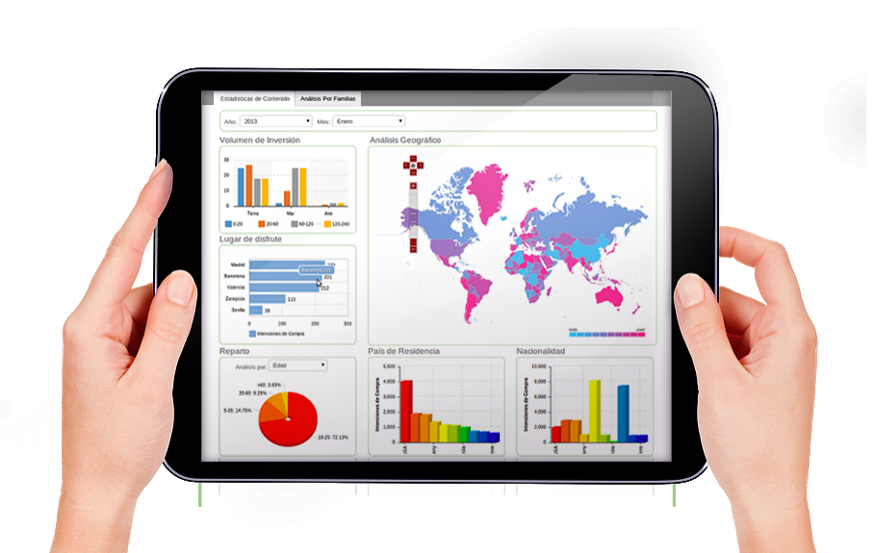
Core Features
Automatic Scheduling, Monitoring & Governance with Biz Intelligence
PM is ensured within due date
Likelihood of Machine Breakdown is Minimised
No Surprise in Maintenance Management
Cost Control to ensure Optimum Spend
Maintenance of M/c is not delayed
due to Gap in communication
Benefits
Copyright ©2022 TRICO. All rights reserved.

Slide 4

Core Features
Auto Visual
Indication of PM
status for each Machine
Green – PM not due
Yellow – PM to be done in next 15 days
Orange – PM to be done in next 7 days
Red – PM overdue
Benefits
Be Proactive than Reactive
Copyright ©2022 TRICO. All rights reserved.

Slide 5

Core Features
Introduce
Governance in
Fuel Management
CPH Monitoring : Actual Fuel consumption for all M/c
Std. Vs Actual CPH of each M/c is monitored over BI
Actual CPH of each M/c type is displayed across Project/Location over BI
Benefits
Optimum Spend in Fuel consumption ensured
Copyright ©2022 TRICO. All rights reserved.

Slide 6

Core Features
Spend Visibility
in Spares & Services
Visibility of M/c under AMC & M/c not covered in AMC
Each Spares & Service POs to be tracked per M/c
Savings Achieved to be calculated and displayed
Benefits
Overspending indication well ahead of time
Copyright ©2022 TRICO. All rights reserved.

Slide 7

Core Features
Highlighting Sales/Production Loss
Sales/Production Loss due to delayed/No PM leading to M/c Breakdown
Benefits
Be Proactive than Reactive
Copyright ©2022 TRICO. All rights reserved.

Slide 8
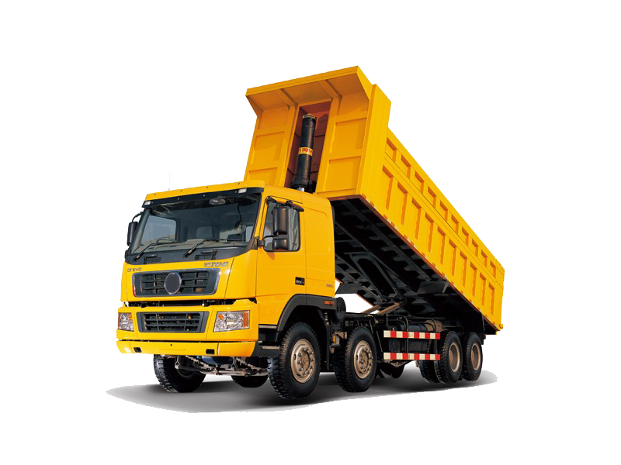
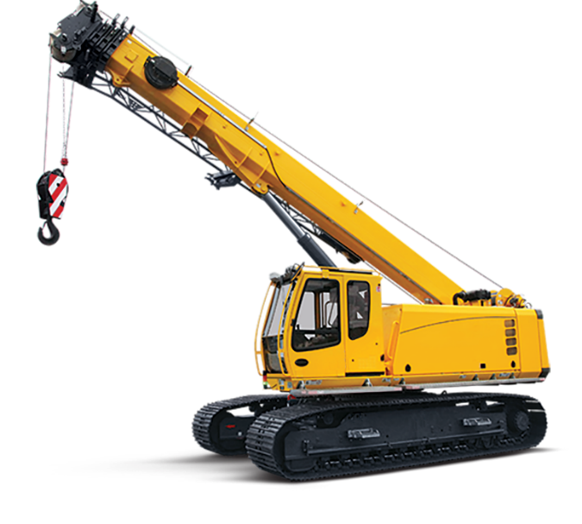
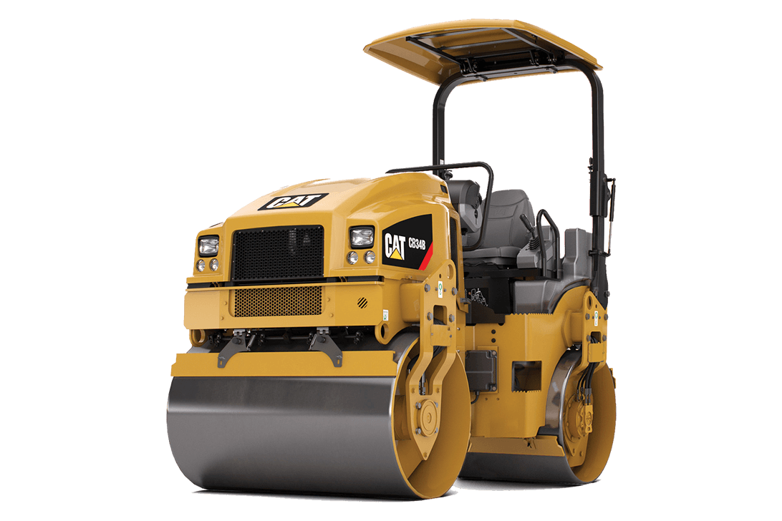
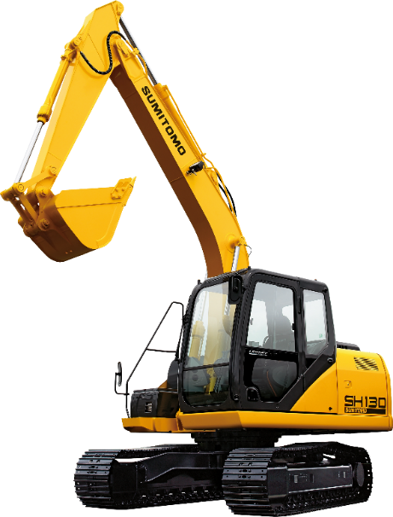
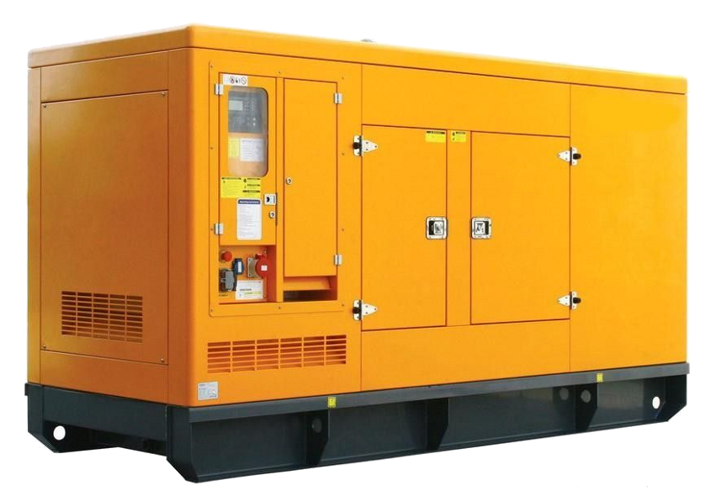
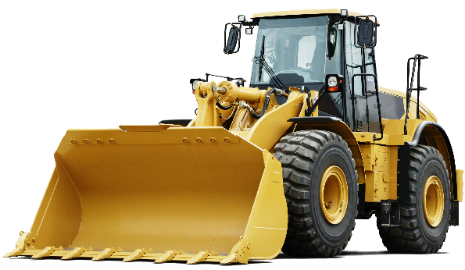
Core Features
Robust Asset Management
Machines ownership, i,e Own – Sister Concern – Vendors identified & Displayed
Benefits
Copyright ©2022 TRICO. All rights reserved.

Slide 9
Thank You
Copyright ©2022 TRICO. All rights reserved.

